Slide 1
Setting the Stage: The Application Platform in Windows Server 2016
Brent Stineman
@brentcodemonkey
Sr. Engineer, Cloud Specialist
Notes:
Content here taken almost entirely from 2015 //BUILD Session “Setting the Stage: The Application Platform in Windows Server 2016”. You can find the original content and a video recording of the session by Andrew Mason and Taylor Brown at: https://channel9.msdn.com/Events/Build/2016/B875

Slide 2
Tenants of Development
Develop – minimize your dependencies
Package – know your dependencies
Configure – use intent based configuration
Deploy – use modular, componentized deployments
Run – use physical hosts, VMs, or containers
Test – use unit tests
Secure – don’t let security be an after thought or add-on
Content © Microsoft
Notes:
There are some core tenants of the development process and the artifacts that you produce along the way.
#quick reach through the list
One of the key things we’d like to talk about today is dependencies. Today we’ll talk about how Windows Server 2016 will help you minimize dependencies through new features such as the NanoServer, and manage them with technologies such as containers to help reduce the confusion about what should be installed and how it should be configured when installing complex solutions.

Slide 3
Operational Models
In previous releases Windows Server hasn’t had a point of view
Variety of artifacts used
No clear set of choices or recommendations
Windows Server 2016 has a clear point of view
Traditional ops model
Emerging model with Containers
Content © Microsoft
Notes:
Along these lines, previous versions of Windows Server hasn’t really provided specific guidance. For example, you could use MSI packages, xCopy deployments, various tools such as the Web Platform Installer to create the artifacts you needed for deployment. There was no clear recommendation, you would opt for a certain path and receive some guidance. With Windows Server 2016, we’re brining in a point of view to help you with selecting the option that best suits your needs.
This may be the “traditional” operations model and Windows Server will have tools to assist with creating the artifacts along those lines. And then there’s the emerging “container” model, which you can leverage either via traditional concepts, or adopt with an “all in” approach.

Slide 4
Windows Server 2016
resolves the interface
between devs and ops
Content © Microsoft
Notes:
What this means is that Windows Server 2016 is evolving into an interface that allows developers and operations to speak the same language. Not just a platform for running applications and services.

Slide 5
Windows Server App Platform
Develop apps using SDK targeting Nano Server
Package apps using Windows Server App (WSA) installer
Configure apps using DSC
Deploy apps and dependencies using Package Management
Run apps in physical, VMs, or containers
Test apps using Pester
https://github.com/pester/Pester
Secure apps using Just enough Administration (JEA)
https://github.com/PowerShell/JEA
Architectural Foundation
Content © Microsoft
Notes:
The Windows Server App Platform, new to Server 2016, has capabilities built into it to help support the development lifecycle.
You being by developing apps targeting the new Nano Server SDK or an open source framework that is running on top of Nano Server. This helps you reduce and manage dependencies as we’ll discuss later in this session.
Package up your applications using the WSA installer. A new install technology we’ve developed.
Package management can then be used to deploy your application and Desired State Configuration, DSC, will assist in its configuration.
The applications can then be tested in a consistent environment via physical or virtual machines, or containers. You can then use tools like Pester (https://github.com/pester/Pester) to test your PowerShell scripts.
Finally, administration is done using the “just enough administration” for PowerShell (https://github.com/PowerShell/JEA)
Now many of these topics are large enough that we could spend an entire hour on any one of them. So this is just a quick overview to help illustrate how Windows Server 2016 will allow your developers to have more of a hand in how the applications will be deployed. This helps ensure that when operations takes ownership there’s a approach and environment that will be used helping ensure consistency and uptime of your application. And hopefully a lot less of “it works on my machine”. ☺

Slide 6
Containers in Windows Server
Develop apps using Frameworks on Nano Server
Package apps as Container Images pushed to repositories
Configure apps using Container Images
Deploy container images from repositories
Run containers though orchestrators
Test apps using your test frameworks
Secure apps using multiple containers and JEA
Content © Microsoft
Notes:
But as we mentioned, there’s also the emerging trend of containers. This was originally pioneered by Oracle (back on Solaris), and have been present in Linux since 2008. But they’re really grown in popularity recently due to management tools like Docker and Mesos. Containers bring in the capability of ensuring that there is process and namespace isolation of applications, preventing one application from blocking another. But even more importantly they bring in a layering concept for managing dependencies.
Much like the WSA approach, we being by targeting Nano Server or frameworks that target it. This ensures we have the smallest footprint server image possible (aka one with very few dependencies).
Containers have their own packaging model called a “container image”. And if our application is going to be running in a container, this is definitely the right approach to take. This allows us to “layer” our application on top of the base container image in a way that’s easily sharable and re-deployable. We could also deploy a WSA into a container image, giving us flexibility to deploy to a physical server, virtual server, or a container.
The container image also handles configuration similar to DSC’s “intent based” principle. We’ll take a closer look at this later on.
Various orchestrators such as Docker, Mesos, the Azure Container Service can be used to help deploy and run your applications.
Containers make it easy to consistently test your applications by giving a solid starting environment that’s easily deployed.
And security for your applications is even better since each application can be kept in its own container, separate from all others and access restricted using JEA.

Slide 7
Developing Apps Targeting Nano Server
Notes:
Lets talk about what Nano Server is all about…

Slide 8
Nano Server: just enough OS
Optimized for next-gen distributed applications
Higher density and Reduced attack surface and servicing requirements
Next-gen distributed app frameworks
Interoperate with existing server applications
Third-party applications
RDS experience
Traditional VM workloads
Containers and next-gen applications
Full GUI
Specialized workloads
Server Core
Lower maintenance server environment
Nano Server
Just enough OS
Content © Microsoft
Notes:
Nano Server centers around the concept of “just enough OS”. Its been striped of as many dependencies as possible and optimized for next-gen applications and containers.
#click (show first column)
This gives you higher density and fewer patches while also reducing the attack footprint by removing unnecessary services. A secure, minimal environment for running applications. Its about 400mb on disk with no extra roles/features added. It is 64bit only.
#click (show second column)
Further up “the stack” is Server Core where you can run traditional workloads or container based applications.
#click (show third column)
And finally is the “full GUI” server with a desktop experience where you can host applications that require a GUI experience or perhaps need to host remote desktop services.

Slide 9
Nano Server: Next step in our cloud journey
Zero-footprint model (just enough OS)
Server Roles and Optional Features live outside of Nano Server
Standalone packages that install like applications
Key Roles & Features
Hyper-V, Storage (SoFS), Clustering, IIS, and DNS Server
.NET Core and ASP.NET Core
And of course… containers
Full Windows Server driver support
Antimalware optional package
System Center VMM and OM agents available
Content © Microsoft
Notes:
In creating our public cloud offering, we’ve learned a lot and brought the benefit of those lessons to you. Nano Server is the next step in this journey.
#click (zero footprint)
Zero-footprint means that all the “optional” roles and features have been removed from the image. These are available in the server core and full versions in a side by side folder. So that if you decide to add them months later, there’s no need to provide the installation media. This means when each time you copy or deploy one of these images, you’re also moving all those bits around on your network. Nano Server makes them separate packages that can be installed much like you would an application.
Coming in the next technical preview (CTP 5) will be to make these roles and features up in the same repository where the container based images are, so you can pull them down easily when you need them.
#click (key roles and features)
Some of the roles/features supported in Windows Server 2016 Nano Service include (read list)
SoFS – Scale out File Server
There’s also support for various 3rd party open source solutions and frameworks which we’ll talk about later.
#click (Full Driver support)
Nano Server uses the same driver stack as the full version of Windows Server 2016. So if you have a driver for Windows Server 2016, it will also work with Nano Server.
#click (Antimalware)
If you install Server Core or the full version of Windows Server 2016, you’ll see Defender is installed by default. Defender is also available for Nano Server as an optional package.
#click (VMM and OM)
VMM and OM agents are also available. Allowing you to easily and remotely manage Nano Server images.

Slide 10
Nano Server: Cloud Application platform
Born-in-the-cloud application support
Subset of Win32
.NET Core and ASP.NET Core
PowerShell Desired State Configuration (DSC)
PackageManagement (aka OneGet)
Open Source Application Frameworks
Available as OS everywhere
Host OS for physical hardware
Guest OS in a VM
Windows Server Containers
Hyper-V Containers
Content © Microsoft
Notes:
#click (born in the cloud)
I want to emphasize again that Nano Server is really targeting “next gen” applications. It was born in the cloud from our own learnings running hyper-scale infrastructure and services. Nano Server is much smaller then Server Core but does contain a subset of Win32. <read feature list that’s included)
Also included is PackageManagement via OneGet (used to help deliver the images and soon the optional features/role packages as well).
#click (available everywhere)
You can run it on a physical machine, as a guest VM, or in either of the container technologies.

Slide 11
Nano Server: Developer Experience
Nano Server has a full developer experience, unlike Server Core
Windows SDK & Visual Studio 2015 target Nano Server
Rich design-time experience
Project template, full IntelliSense, error squiggles, etc.
Full remote debugging experience
Content © Microsoft
Notes:
#click (nano server)
We learned from the previous Server Core that we need a full developer experience. So with Nano Server, there’s a complete SDK specifically focused on Windows Server. Where something like the Universal Windows Platform API focused on a client application experience, the Server SDK focuses on server experience.
#click (visual studio)
This includes integration with Visual Studio 2015 via a template that you can download.
#click (rich design-time)
This is complete with full intelliSense, error squiggles, etc… If you take your existing code and bring it into this template it will give you all the errors to let you know if you’re using something that’s not available in Nano Server.
#click (remote debugging)
And as you would expect from Visual Studio, a robust remote debugging experience

Slide 12
Server Application Development
Deep refactoring
Client stack for RDS
Developers target Nano Server
Deploy to Physical, Virtual or Containers
Remote Desktop Server
Local Admin Tools
Client
(aka Server w/a Desktop Exp)
(Aka Full Server)
Physical, Virtual, Containers
Server Core
Nano Server
Content © Microsoft
Notes:
Targeting Nano Server directly requires some deep refactoring of existing applications. This is due to the large number of “optional” packages that are not present in this version of Windows Server.
#click (Server Core)
Layered on top of that is Server Core which gives you more functionality. An easier path is to start by targeting Server Core, then moving down the stack to Nano Server.
#click (clients)
Layered on top of this is the client and desktop experience (aka full server).
#click (RDS Admin)
It comes with Remote Desktop Server and local admin tools. In Server and Nano, its about remote administration.
#click (no-client)
The client stack is really there to support RDS, not run server apps.
#click (developers target)
The server app target is really for Nano Server, with Server Core being present for app compatibility purposes. This gives you the smallest footprint and
#click (deploy)
Target existing physical, virtual, or container deployments.

Slide 13
Porting Existing Apps to Nano Server
Say hello to Reverse Forwarders!
A missing DLL will result in your code failing to run
Provide a way to run existing code without recompiling code for Nano Server
With Reverse Forwarders, your code will load and API calls in those DLLs will either result in
API call succeeding if the API is in the Nano Server boundary
Return of “Not Implemented exception” if it is not within the Nano Server boundary
Does not eliminate the need to refactor code to what is available in Nano Server
Content © Microsoft
Notes:
If you’ve tried to port an existing app to Server Core in the past, you likely noticed that this was not a pleasant experience. We didn’t have any real tool support in visual studio and simply provided a list of APIs on MSDN. We’ve put some capabilities in Nano Server we hope will make this easier.
The biggest of these are the reverse forwarders
#click (Hello reverse forwarders)
When we refactored Windows Server to create Nano Server, we a lot of “shell” apis scattered around the Windows Server operating system that performed various operations. In Nano Server we didn’t want to bring along all those shells, so we moved those API’s down into different DLLS to keep it small and focused.
#click (missing DLL)
If there’s a DLL you are linked to that’s missing from Nano Server, Reverse Fowarders will provide a thin “shim version” so those APIs will continue working.
#click (With Reverse Forwarders)
So if you were using a higher level API to interact with the registry or file system, those APIs will redirect to the new version of the API (if its available). So you don’t need to relink and recompile to take advantage of the new APIs.
#click (Does not eliminate)
This doesn’t actually eliminate the need to refactor to what’s available. Some APIs may not be available in Nano Server. So you may want to refactor the next version of your application to move fully target Nano Server. Note that this does not exclude you to from continuing to take advantage of Server Core.

Slide 14
Reverse Forwarders
Optional package that can be included in a Nano Server image when needed in TP4 and earlier
Available reverse forwarders include:
advapi32.dll
comctl32.dll
comdlg32.dll
gdi32.dll
kernel32.dll
ole32.dll
psapi.dll
secur32.dll
setupapi.dll
shell32.dll
shlwapi.dll
tdh.dll
user32.dll
version.dll
winmm.dll
Content © Microsoft
Notes:
The reverse forwarders have proven so valuable and requested, that starting in Technical Preview 4, we moved these from Optional packages for Nano Server to be automatically included. So there’s no need to install them separately.
How the dll’s listed here are extremely useful in previous versions of Windows Server. In Nano Server, the same DLL’s are not present any longer. Instead they have been replaced by the appropriate shims.

Slide 15
What runs today with Reverse Forwarders?
Chef
PHP
Nginx
Python 3.5
Node.js
GO
Redis
MySQL
OpenSSL
Java (OpenJDK)
Ruby (2.1.5)
SQLite
Content © Microsoft
Notes:
The benefit of using these is that we’ve been able to get many popular 3rd party and open source solutions working on Nano Server using the reverse forwarders package.

Slide 16
Creating/Porting Application to Nano Server
Use Reverse Forwarders to test your app
For Native code
Use Visual Studio Nano Server project template to create a new Nano Server application
Or, use NanoServerApiScan.exe
http://blogs.technet.com/b/nanoserver/archive/2015/11/16/native-binary-scanning-tool-nanoserverapiscan-exe-for-nano-server.aspx
For Managed code
Refactor your code to .NET Core
API Portability Analyzer
http://www.microsoft.com/en-us/download/details.aspx?id=42678
Content © Microsoft
Notes:
When porting your solution to Nano Server, start by deploying it to Nano Server (with the reverse forwarders package) and try your app.
We’ve also provided two tools that can scan your application and will recommend changes based on the API available in NanoServer.
For Native apps, either rebuilt then using the Visual Studio Nano Server project template, use the NanoServerApiScan. For Win32 applications this will tell you what APIs you’re using that are not available in Nano Server and in many cases suggest a replacement. We are using this tool internally as we do our own work to port things to Nano Server, both internal applications/services as well as open source projects.
For managed code (.net), refactor for .NET Core or leverage the API Portability Analyzer.

Slide 17
Demo APIScan
Content © Microsoft
Notes:
3 Minutes – Focus on showing you the APIScan tool and difference the forwarders can make
Uses a powershell script in PowerShell ISE to run the following commands
dir .\sysinternals
.\NanoServerAPIScan.exe /binarypath:”C:\demo\sysinternals”
.\NanoServerAPIScan.exe /binarypath:”C:\demo\pre-port sysinternals”
.\NanoServerAPIScan.exe /binarypath:”C:\demo\pre-port sysinternals” /reverseforwarderspath:c:\demo\reverseforwarderstp4
# show difference in base size of items like user32.dll (25k for the forwarder, vs 1.4mb).
ls reverseforwarderstp4
ls c:\windows\system32\user32.dll
.\NanoServerAPIScan.exe /binarypath:”C:\demo\ported sysinternals” /reverseforwarderspath:c:\demo\reverseforwarderstp4

Slide 18
Containers and Nano Server
Notes:
How many folks have used containers in the last year? How many have looked at Windows Containers?

Slide 19
Windows Server Containers
Container Host
System Processes
Session Manager
Container Management
Local Security Authority
Windows Server Container
Windows Server Container
Docker Engine
Event Manager…
System Processes
Application Processes
System Processes
Application Processes
Compute Services
Etc…
Windows Kernel
Content © Microsoft
Notes:
One of the things that kind of interesting is that we have a couple of container runtimes. We’ll start with Windows Server Containers. These are very similar to the Linux container model. We have our Windows Kernel…
#click (container host box)
And a container host which has…
#click (system processes)
Set of system processes that you’re likely to see on any windows server.
#click (container management)
And then we have container management. Our compute services which is our layer of containers in the operating system. And the Docker engine.
#click (Windows Server Container)
When we actually start a container, what we’re doing is starting up a new “user mode” and put copies of each of those system processes in.
#click (Application Processes)
And then the application process, whatever you put on the “docker run” line. If it was an IIS web server, it would have it own w3wp process. The reason for this model is that without these processes, we couldn’t have isolation between containers. You couldn’t make your own user name as it would be shared by the host. This way its specific to the container. Now you’d think this would be somewhat heavy with all these extra processes. But we’ve actually done a great deal of optimization around memory and startup time such that we can start up a Nano Server container in about 1.15 seconds right now and our goal is to get this down to a second by the time Windows Server 2016 ships later this year. We think this is a pretty amazing startup time. We also haven’t seen much memory overhead from these processes, and they give us that high degree of isolation folks expect from containers.
#click (second Server Container)
And of course we can have multiple of these containers running side by side. Each representing their own set of “user mode” processes. This is a fairly traditional container model, but being Microsoft, we really aren’t satisfied with being traditional. So we came up with another model.

Slide 20
Hyper-V Containers
Container Host
System Processes
Virtual Machine Specifically Optimized To Run a Container
Session Manager
Hyper-V Container
Container Management
Local Security Authority
Windows Server Container
Docker Engine
Guest Compute Service
Event Manager…
System Processes
Application Processes
Compute Services
Basic System Processes
Etc…
Windows Kernel
Windows Kernel
Hyper-V Hypervisor
Content © Microsoft
Notes:
Hyper-V containers differ from Server Containers in that they start with the Hyper-V HyperVisor.
#click (Container Host)
Then we add a container host.
#click (Windows Kernel)
This contains the Windows Kernel
#click (System Processes)
The same set of System processes
#click (container management)
And our compute services and dicker engine. Much like we have with a Server Container Host.
#click (hyper-V Container)
But when we start a Hyper-V container, things starts to look different.
#click (Window Kernel)
The hyper-V container has its own copy of the Windows Kernel
#click (Basic System processes)
It has its own set of Basic System Process. This is a minimal set, just enough to launch
#click (Guest Compute Service)
The Guest Compute Service.
#click (Windows Server Container)
And a Windows Server Container.
#click (System Processes)
Which in turn then has its own set of System Processes
#click (Application Processes)
And application processes.
#click (Virtual Machine)
All this happens with a specially purposed Virtual Machine. This virtual machine has only one purpose in being, to run a container. We did this so that we get the same isolation boundaries that a traditional virtual machine has. If, unbelievably, someone were figure out some weird way to get outside of the container and mess with the kernel, they could crash themselves, but would be unable to hurt anyone else. This also means we have kernel independence, we could run different versions of the kernel. We could run the app on different versions of the operating system and all sorts of interesting things we’ll get into later.

Slide 21



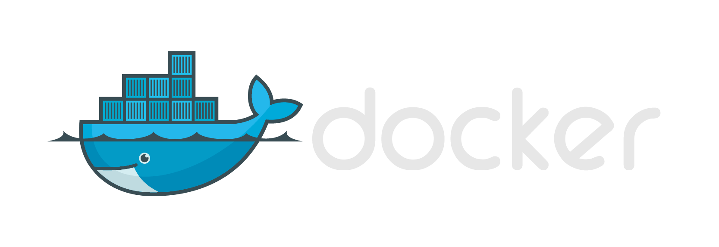



Same Container Images, Same API
Windows Container Images
Container Run-Times
Hyper-V Container
Container Management
Docker
Application
Framework
Windows Server Container
Write once, deploy anywhere
Content © Microsoft
Notes:
And given that we’re running a container inside of this optimized virtual machine
#click (windows container images)
these are the exact same container image format
#click (docker)
And exact same management API. To docker, its as simple a the difference in one flag to deploy to a Windows Server Container or a Hyper-V Container. This gives us a great degree of flexibility. When we’re running in our own environment where we know what all is running, we can use Windows Server Containers. But if we opt to want to move to a public cloud where there’s lots of different tenants, we can take advantage of the higher degree of isolation by running Hyper-V containers.

Slide 22
Operating System Deployment Modes
Windows Server Containers
Container must match host (i.e. Nano on Nano) will be relaxed in the future…
Hyper-V Containers
Container must be Nano Server. Server Core support coming…
Host can be Nano Server, Windows Server Core or Windows Server w/Desktop
Container
Container
Container Host
Container Host
Nested Virtual Machine
Virtual Machine Host
Physical Server
Physical Server
Content © Microsoft
Notes:
So a couple notes on the deployment model…
With Windows Server Container, the container must be matching the host. If I’m running a Nano Container, it must be running on a Nano Container Host. Server Core must be on Server Core. We’re working to relax this for the General Availability of Windows Server 2016, but at least through Technical Preview 5, this will be the case.
With Hyper-V containers, we currently only support Nano Server containers, at least through TP5. Server Core support will arrive by the time Server 2016 GA’s. However, the host can be anything we want… Nano Server, Server Core, or even Windows Server/Desktop. This is because the hyper-v container has its own, independent copy of the kernel.

Slide 23
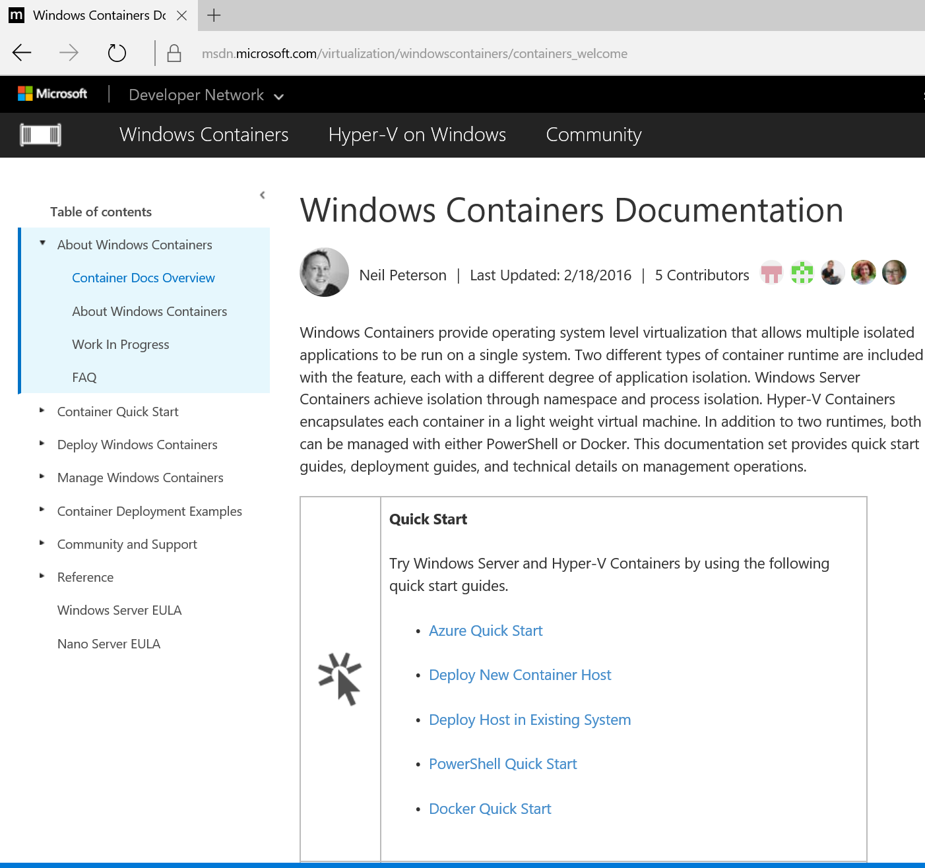
Where To Run Containers
Azure
Windows Server 2016 TP4 Image In Marketplace
Only Windows Server Containers
Existing Server/Physical or VM
Install Windows Server 2016 TP4
Windows Server and/or Hyper-V Containers
Nested Virtualization on Hyper-V
VM on Windows 10 or Windows Server 2016 TP4
Windows Server and/or Hyper-V Containers
http://aka.ms/containers
Content © Microsoft
Notes:
This said, there are several options for hosting your containers…
You can use Azure to host the Windows Server 2016 Technical Preview 5 image already in its marketplace gallery. This currently only supports Windows Server Containers. Nested virtualization support is coming to Azure, and then we’ll be able to Hyper-V containers in the not to distant future.
You can run them on an existing physical or virtual server. Start with a Windows Server 2016 TP4 image, install the Hyper-V and Containers roles/features, and then you can host Windows Server and/or hyper-V containers.
And finally, with nested virtualization either on Windows 10 or Windows Server 2016 host and run Windows Server and/or Hyper-V containers there.

Slide 24
Demo Nano Server and Hyper-V Containers
Content © Microsoft
Notes:
3 minutes
So lets take a quick look at one of these new features, Hyper-V containers running natively on Windows 10.
Requires:
container and hyper-v features of Windows 10 (RS1 build 14295) or Windows Server 2016 CTP 5
Also requires docker for windows: https://msdn.microsoft.com/virtualization/windowscontainers/quick_start/manage_docker
#starts up an optimized VM in the background for an interactive nanoserver container with a command prompt
#this can take 10-20 seconds to start
docker run --net=none -it --isolation=hyperv nanoserver cmd
#switches to windows server system32 cmd prompt (a nanoserver container running natively inside hyper-v)
cd \
Dir
Ipconfig
#powershell takes a few seconds to start up
Powershell
Get-ChildItem “HKLM:\SOFTWARE\Microsoft\Windows NT\CurrentVersion\Server\”
And there we have some proof that our container is actually a Nano Server container running on a Windows 10 desktop host! How’s that? Are you not entertained!
What this does for us is make building your applications on Nano Server super easy. Use familiar tools in your existing development environment, and if you make a mistake…
C:\> Exit
C:\> Exit
That was it, I’ve exited out of my container. All the changes get thrown away. No harm, no foul. Now I can go back, recompile my binary, push it back in when I’m ready to go and I’m done!

Slide 25
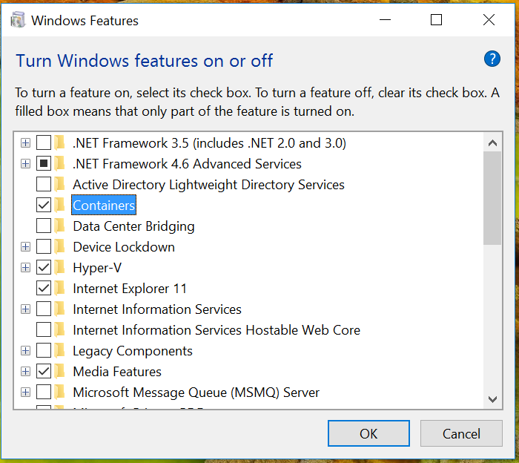
Windows 10 and Hyper-V Containers
Platform support in Windows Insider builds
Enable the “Containers” and “Hyper-V” Feature
Nano Server Only
Windows Server Core support coming…
Docker Engine and Container OS Image available along with Windows Server 2016 Technical Preview 5 soon…
See http://aka.ms/containers
Content © Microsoft
Notes:
Support for this is in some Insider builds today (enterprise Redstone build 14295 and other versions coming soon) and will be present in the Windows 10 Anniversary update coming later this year for enterprise and pro editions. You will need to enable the Containers and Hyper-V features as shown here.
Currently, this is for Nano Server only ,but Server Core support is coming and should be here by the time the Anniversary Update ships.
The Docker Engine and Container OS Image will be available along with Windows Server 2016 TP5 which should be landing very soon.
So bear with us and keep an eye on aka.ms/containers for all the latest. Once this launches we’ll make quickstart guides and other resources available there.

Slide 26
Packaging apps using Windows Server App (WSA) installer
Notes:
So enough about containers for a moment, lets switch back over to Windows Server Apps…

Slide 27
MSI is not supported on Nano Server
Can’t just port MSI to Nano Server
MSI has significant GUI dependencies
Custom Actions allow for any code to be run
Reliability
Custom Actions can be fragile
No guarantee that uninstall actually removes all installed assets, potentially leaving the system in an unknown state
Content © Microsoft
Notes:
As we mentioned earlier, MSI’s are not supported on Nano Server. They have some dependencies that are not available on Nano Server such as a GUI interface. MSI’s also usually include customer actions that can do nearly anything in the system.
For reliability purposes, these are not supported on Nano Server. These could be calling things that are not available on Nano Server. This caused a lot of pain on Server Core where we did support MSI’s and there was never an easy way to know without simply trying it on Server Core. So we’ve decided that for Nano Server, it was best to not support this approach.

Slide 28
Windows Server App (WSA) installer
A new Server installer based on declarative APPX
Declare install actions in a manifest
Promotes Server specific install actions to first class citizens
Allows intra package dependencies
Not specific to Nano Server
Will be available in Server Core and Server with Desktop Exp
Extends the AppX schema
Allows for Server specific Extensions, such as NT Services
Content © Microsoft
Notes:
On the Windows Client side, everything has been moving towards the APPX package. So the WSA installer is also based on APPX. Those of you familiar with the APPX client packages may be thinking…
Well this constrains me, my app must run in a sandbox, its limited to specific capabilities with regards to accessing the system. What does this mean for trying to install something on Windows Server?
So for WSA we’ve created a series of extensions that allows WSA packages to “break out” of the sandbox. So you are not as constrained as you are with a Windows client APPX package. This includes capabilities like allowing services that have full access to the system.
Now if you’ve heard about our “Centennial” bridge for Windows Client apps. Centennial and WSA have some overlap for consistency, but our goal by Windows Server 2016 GA is that a Centennial app that installs on clients will be able to be deployed as a WSA.
WSA’s are not specific to Nano Server, it will be consistent across Server apps “all up” and can be used on Server Core and serer with a desktop as well. This gives you a single installer you can use across any of the Windows Server 2016 installation options.

Slide 29
Windows Server App (WSA) Installer (cont.)
Developers describe Server Extensions in the WSA manifest
Supports online install
Roadmap includes plans to support offline install (post Windows Server 2016)
Does not allow custom actions during installation
More consistent and reliable installs and uninstalls
Content © Microsoft
Notes:
Creating a WSA is much like creating a typical client APPX package. The basic schema is the same, we’ve just added some extensions. Its very much APPX until you start getting into the extensions. You will describe your package in a manifest.
Windows Server 2016 we will only be supporting online install. Offline install is on the roadmap but will come post RTM/GA.
One significant difference between WSA and MSI, there is no custom actions allowed during installation. You need to describe what you’re installing on the system and provider further configuration via DSC or via the application on initial startup.

Slide 30
Declarative Server Application
Files and Registry
Server Extensions
NT Services
COM Objects
WMI
Performance Counter*
ETW events*
* - additions scheduled for Technical Preview 5
Content © Microsoft
Notes:
WSA is a declarative installer that lets you do file and registry just like a client APPX package. But we also have a series of extensions.
I mentioned services earlier, but we also have com object and WMI provider support. Performance counters and ETW events are coming in the next technical preview.

Slide 31
When to use WSA
Need to support installation on Nano Server
Installation involves system/OS level changes
Requirements to
Support Uninstall and Servicing
Declare dependency on Windows features or framework packages (post Windows Server 2016)
When not to use WSA, must
Have a GUI
Take interactive user input
Run custom code
Content © Microsoft
Notes:
As for WHEN you should use WSA versus an MSI or other technology.
If you are targeting Nano Server, WSA is the only way to go.
WSA provides the capability to make system and OS level changes. It does not constrain you like a client APPX package would.
If you need to support uninstall or servicing or declare feature/framework dependencies, WSA is the way to go. We will be adding the ability to declare dependencies on in-box components such as IIS. In your app you would declare that dependency and if its not already installed, it would be installed for you as part of your WSA install process. You won’t have to have your ops team go through and add that component for you before the WSA is installed.
So like a client APPX package, WSA do not have a GUI and can’t take interactive user input on install. It will simply deploy the files, registry entries, and any dependent packages you’ve described in the extensions. Since custom code is also blocked, your application will need to set those up the first time it is launched. However, if you require any of these options (GUI, user interaction, etc…) you will need to use an MSI package or other installer. Which, as a reminder, will not be supported on Nano Server.
Now, as you can see we’re still actively working on WSA. Some of these features are coming in the future including some post-RTM. So if you have feedback on capabilities you need in WSA, please let us know. We want to keep evolving this and ensure it meets the needs of server apps out there.

Slide 32
WSA Packaging and Installation
WSA Packaging
Author Manifest file
Use MakeAppx.exe to create the WSA (.appx) package
Digitally sign. E.x. signtool.exe sign xxx.appx
Requires Windows SDK
WSA Installation
Using AppX cmdlets
Copy the WSA package to Nano Server
Add-AppxPackage
Using PackageManagement cmdlets
Add WSA package source with Register-PackageSource
Install-Package
Content © Microsoft
Notes:
Packaging itself is pretty straight-forward. You will author a manifest file then use MakeAppx.exe as you would any other APPX package. Finally you have to digitally sign it. Essentially this is the same workflow you go through for any client APPX package such as a UWP app.
As far as installation goes, the APPX cmdlets you use today are included in Nano Server. You can also use PackageManagement to pull packages down from a remote source and install them.

Slide 33
Demo WSA
Content © Microsoft
Notes:
4 minutes

Slide 34
WSA Resources
WSA Introduction:
http://blogs.technet.com/b/nanoserver/archive/2015/11/18/installing-windows-server-apps-on-nano-server.aspx
WSA deep dive:
http://blogs.technet.com/b/nanoserver/archive/2015/11/19/hands-on-packaging-and-installing-your-first-windows-server-apps-on-nano-server.aspx
Questions and feedback- nanoserver@microsoft.com
FireGiant and WiX Tool: https://www.firegiant.com/wix/appx/
Provides commercial support for the WIX toolset and support the WIX community
Created a commercial tool for WiX that will allow you to generate a WSA in addition to an MSI
Content © Microsoft
Notes:
We have some resources ready on the NanoServer Blog today. We’ll be moving much of this over to MSDN in the coming weeks and adding additional content to help guide you in building WSA packages.
If you have questions, please reach out to the nanoserver@microsoft.com.
In addition to the appx tools in the Windows SDK, we’ve been working with FireGiant and Flexera. Firegiant is the commercial provider for WIX. They have already released an extension that will allow you to produce both a WSA and MSI package. We’re working with Flexera to help craft something similar for Installshield.

Slide 35
Drivers on Nano Server
Not supported by WSA in Windows Server 2016, drivers remain INF-based
PnP Drivers
PnP drivers can be offline installed using INF via DISM
Online install driver will be available in Windows Server 2016
File system and minifilter Drivers
Expanding INF syntax to support file system and minifilter drivers on Nano Server
Offline install will be available in Windows Server 2016
Online install will be available post Windows Server 2016
Content © Microsoft
Notes:
I mentioned earlier that we wanted to speak about drivers. Drivers will not be supported via WSA in WS2016. Driver installation will remain INF based.
We will be producing a script you can use to build a Nano Server image that will allow you to inject your drivers into the image. This will be a simple “drivers” flag with a path to where the drivers are located, making it very easy to include drivers in any Nano Server images you create.
You will also be able to use DISM to install offline hardware plug and play drivers. Online support is coming but will not be present in TP5. PNPUtil is coming to NanoServer, once that arrives you’ll be able to use it to install online drivers in Nano Server.
For filter system drivers, you may have to modify your INF syntax. There are some differences between network and file system filter drivers. The product team is working with the drivers team to unify that syntax. This will help make offline installs possibly in Nano Sever, with online coming some time after.
DISM = Deployment Image Services and Management
Replaced package manager and other tools starting with Server 2008 and Windows 7
https://msdn.microsoft.com/en-us/library/windows/desktop/dd371719(v=vs.85).aspx

Slide 36
Building Container Based Applications
Notes:
Ready for more containers? Awesome, lets take a little bit about how we go about building container based applications.

Slide 37
Container Image
Docker Image
What is a container image?
Templates for containers
Read-only
File based
The Docker Implementation
Metadata
Layers
Creation
Manually
Automated with a dockerfile
Pulled from a registry
Image metadata (json)
Layer-1
Layer metadata (json)
Layer payload (tar)
Layer-2
Layer metadata (json)
Layer payload (tar)
Layer-x
Layer metadata (json)
Layer payload (tar)
Content © Microsoft
Notes:
So to help level set…
#click (what is a container image)
What is a container image? Its really a read-only, file based template for containers. It started from a “base image” and contains all the files that are necessary to for the image along with some metadata.
#click (docker image blocks)
If you opened a docker container image, this is what you’d see inside. We start with image meta data, a JSON file that holds details like the name of the image, who created it, its history, a SHA hash of the image. Then you’d see one or more layers, and this is where the magic happens. Each layer has its own json metadata manifest and its specific payload. These layers exist to help us simplify the image build process. If are we need to change a layer, only that layer will be rebuilt when we build the image. This gives us some incredible flexibility
#click (creation)
We have three approaches to get an image. Manual – you can interact with a container, install applications, make file changes, all the things you do when you set up an application. And when you’re done, you simply do a “docker commit”. But this isn’t very “devops’y” or efficient over all.
Dockerfile – is more efficient as it provides an automated way to produce a container image. Its essentially a “make” file for container images. We’ll take a closer look at this in minute.
Registry – an finally, I can pull a container image from a container registry like Docker Hub. If I needed redis I would simply “docker pull redis”.

Slide 38

Dockerfile
Method for automated container image creation
Consumed when running “docker build”
Enables automated builds via docker hub
Caches unchanged commands
IIS Image
FROM nanoserver
ADD unattend.xml /unattend.xml
ADD packages /packages
RUN dism /online /apply-unattend:.\unattend.xml
WebApp Image
FROM iis
ADD mysite.htm inetpub\mysite.html
Mysite.html
Sandbox
Layer 2
microsoft/iis
Sandbox
Layer 1
Container OS
Image
Content © Microsoft
Notes:
Lets take a closer look at a Dockerfile as this is really the preferred method if you can’t pull an existing image from a registry.
#click (method for automated creation)
read
#click (consumed when running docker build)
Its consumed when we say “docker build”. The build process reads this file
#click (automated builds via docker hub)
It can also be used as part of automation. You can upload your dockerfile to the docker hub, it will help perform automated, triggered builds. So if an image (layer) that you’re dependent on changes, your image will also be updated. This includes a web hook that you can use to start any CI testing or even a redeployment of your image.
#click (cache unchanged commands)
Anything that’s unchanged, just gets cached and reused.
#click (IIS Image)
If we take an example of a dockerfile to build an IIS image.
From – we start with where we’re starting from, in this case a base Nano Server image. Then we have two ‘adds’
Unattended – the first is an unintended install file and this is how you’d install IIS with nano server technical preview 4
Packages – then we add in this case, the “packages” folder where those optional roles/features are stored as we discussed earlier.
Run – then within the container we’re going to use DISM to apply the unattend file we added.
When its all done, we’ll have the layers we see on the right with the base image at the bottom, and our layers added on. Mysite depends on IIS, which depends on the Container image. Now if I wanted to share this with you, and you already have the container base image, all I’d need to ship him is the IIS image, and web image. If he had the IIS image, I’d just send him the web image. I only need to give him enough to provision what he needs to get started.
This makes this approach very handy for sharing work.
And there’s the 4 basic steps to build your own IIS container image.
So lets talk about what “unchanged values are cached”. Lets say I made an mistake and I need to change the folder where my attend file was. Docker’s build process will look at it and say “I’ll keep the first three layers, and only throw away the last one”. So it’s the only one that gets re-run. It doesn’t have to re-add the unattend file, or the packages. It just updates the run layer.
#click (WebApp image)
Now IIS is pretty useless without a web site, so lets create a new image that add this
From – we’ll use the image we created previously
Add – and I’m going to add mysite.htm to the image in the /inetpub folder

Slide 39
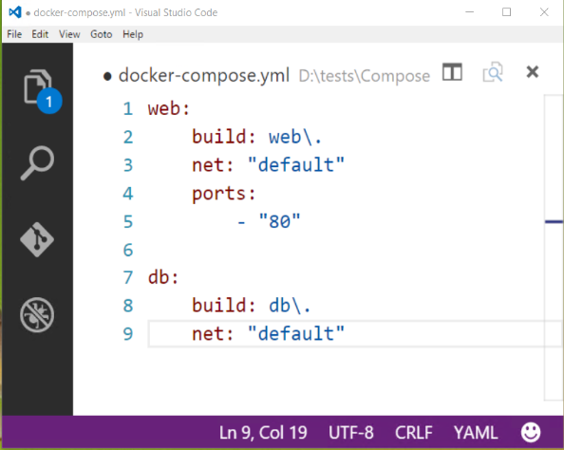
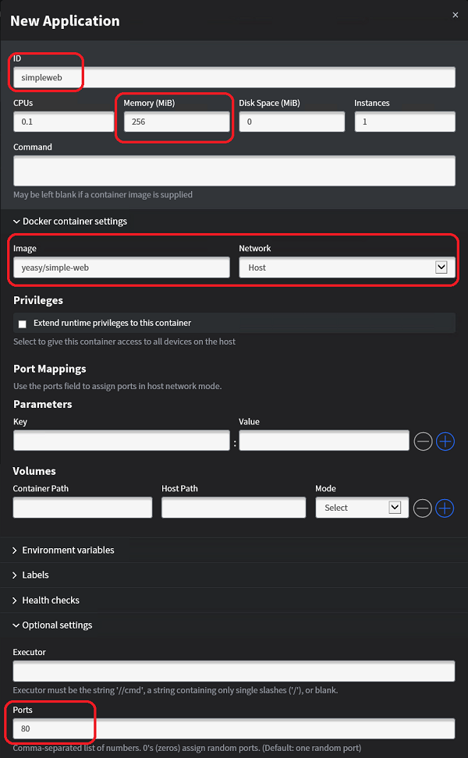
Composition and Orchestration
Docker
Compose
Defines a multi-container application
Start/stop all containers via a single command
Scale independent allocation tiers
Swarm
Aggregates container hosts
Supports tagging, affinity/anti-affinity
Mesos/Mesosphere + Marathon
Aggregates container hosts
Web based UI
Service Launch and Discovery
Utilizes the docker command line
Content © Microsoft
Notes:
Now lets talk about composition and orchestration. Because what’s really interesting is applications that have multiple pieces.
#click (Docker)
In the Docker world, this is defined by two tools, Compose and Swarm. We’ll focus most of our time on Compose.
Compose – allows us to define a multi-container application. In the example shown here we have a 2-tier application with a web site and a database. We see some details about both these layers and we’ll dive into this in a little bit.
I think issue the command “docker compose up” to start up both the database image and the web image. This operates against the application and not just the individual containers. This also allows me to scale the independent tiers of the application.
What Swarm does is aggregate a set of container hosts. So imagine 10 different virtual machines all acting as container hosts, across 2 different datacenters, Swarm makes them look like a single docker host. Allowing me to operate on the set of hosts, as if it was a single host machine. It has rich support for tagging as well as affinity or anti-affinity settings.
#click (Mesos)
So another orchestration technology is Mesos and Marathon. It also allows you to aggregate container hosts like Swarm, had a web based UI. It really excels at service launch and discovery capabilities. But it still uses the docker command line and is therefore fully compatible with docker images as well.
Both of these are great options. And we support them both as part of the Azure Container Service. An alpha-version preview of Swarm for windows will be available with TP5.

Slide 40
Demo Docker Compose
Content © Microsoft
Notes:
5 minutes

Slide 41
PowerShell For Docker
Docker Client
Docker Compose
Docker Registry
Docker Swarm
Docker Engine
Operating System
Content © Microsoft
Notes:
We’re doing PowerShell for docker…
So we have this model where we’ve got the operating system
#click (Docker engine)
The docker engine
#click (top tier)
And today we have a couple different things that can talk to the docker engine. The client, compose, registry, and swarm. So we’ll be introducing PowerShell to this as well.

Slide 42
PowerShell For Docker
Soon to be released open source
Builds on the Docker Engine’s REST Interfaces
Will replaces the existing container module
We need you!
Windows PowerShell
Copyright (C) 2016 Microsoft Corporation. All rights reserved.
PS C:\> New-Container
PS C:\> Get-Container
PS C:\> Get-ContainerImage
Docker Client
PowerShell
Docker Compose
Docker Registry
Docker Swarm
Docker Engine
Operating System
Content © Microsoft
Notes:
Powershell for Docker will soon be released as Open Source on GitHub.
Its built on top of Dockers REST API
This will replace the existing container module that we have in Windows Server today.
So no longer will we have to choose between PowerShell and another scripting language. The PowerShell you use today, will be able to help manage your containers. And because this will work against the Docker REST interface, it will work for Linux also. You’ll be able to manage your linux containers remotely just like you do your windows containers.
Since this will be an open source effort, we need you to help make it the most usable and friendly experience possible. So look for the announcement and be sure to let us know what you think.

Slide 43
Windows Server 2016 resolves the interface between dev and ops
Notes:
So hopefully what I’ve been able to show today is how we’re blurring the artificial lines between dev and ops. With all these new capabilities we’re building into Windows Server 2016.

Slide 44
App Platform
Develop apps using SDK targeting Nano Server
Package apps using Windows Server App (WSA) installer
Configure apps using DSC
Deploy apps and dependencies using Package Management
Run apps in physical, VMs, or containers
Test apps using Pester
Secure apps using Just enough Administration (JEA)
Call to Action
Target Nano Server
Create WSAs
Deploy using Package Management
Give us feedback on:
Missing Reverse Forwarders
Installer functionality needed in WSA
Package Management
nanoserver@microsoft.com
https://windowsserver.uservoice.com/forums/295047-general-feedback
Content © Microsoft
Notes:
We’ve made a lot of news pieces Nano Server, Windows Server App Installer, and expanded package management.
So we need you to start targeting Nano Server. Look at starting to port your apps to Nano Server, let us know about missing reverse forwarders or other capabilities. What’s missing from WSA that we need to be considering?
To that end we have a email address that flows directly into the inbox of the product team, and a public User Voice site for feedback. The sooner you try things and let us know your feedback on the experience, the sooner we can try to make those improvements. Hopefully in time to get them into Server 2016!

Slide 45
Containers
Develop apps using Frameworks on Nano Server
Package apps as Container Images pushed to repositories
Configure apps using Container Images
Deploy container images from repositories
Run containers though orchestrators
Test apps using your test frameworks
Secure apps using multiple containers and JEA
Call to Action
Learn more about Windows containers http://aka.ms/containers
Give your apps a try in Windows containers
Help with PowerShell for Docker
Get ready for Technical Preview 5!
Continue providing feedback and bug reports
http://aka.ms/containers/forum
https://github.com/Microsoft/ Virtualization-Documentation
https://github.com/docker/docker
Content © Microsoft
Notes:
To learn more about containers check out aka.ms/containers
Give the documentation a try and since its all backed by github, please feel free to submit any updates/changes you think need to be made.
Give you apps in a try in containers! In TP5 you’ll be able to do this with Windows 10. It’s the feedback from early users that give us the feedback that we need to make the products better.

Slide 46

Brent Stineman
DX/TED, Azure Specialist, Cloud Evangelist
Email: brestin@microsoft.com
Twitter: @brentcodemonkey
Web: http://brentdacodemonkey.wordpress.com
→
Creating quality bugs since 1992!
Content © Microsoft

Slide 49
Safe Harbor Statement

